Slide 1
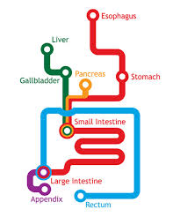



Inflammatory Bowel Diseases
Update 2020
- For Patients -
Oesophagus
Liver
Pancreas
Stomach
Gallbladder
Small intestine
Michael Schultz
@GastroOtago
@OtagoMedDept
Large intestine
Notes:
greeting

Slide 2
Disclaimer:
“The content of this presentation is provided for informational purposes only and is not intended as medical advice, or as a substitute for the medical advice of a physician.”
Notes:
greeting

Slide 3

Agenda
What is Inflammatory Bowel Disease?
Treatment – now and in the future

Slide 4
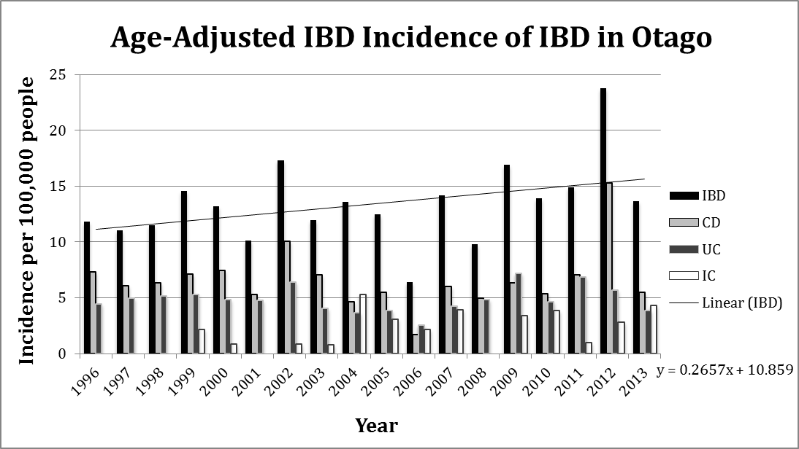
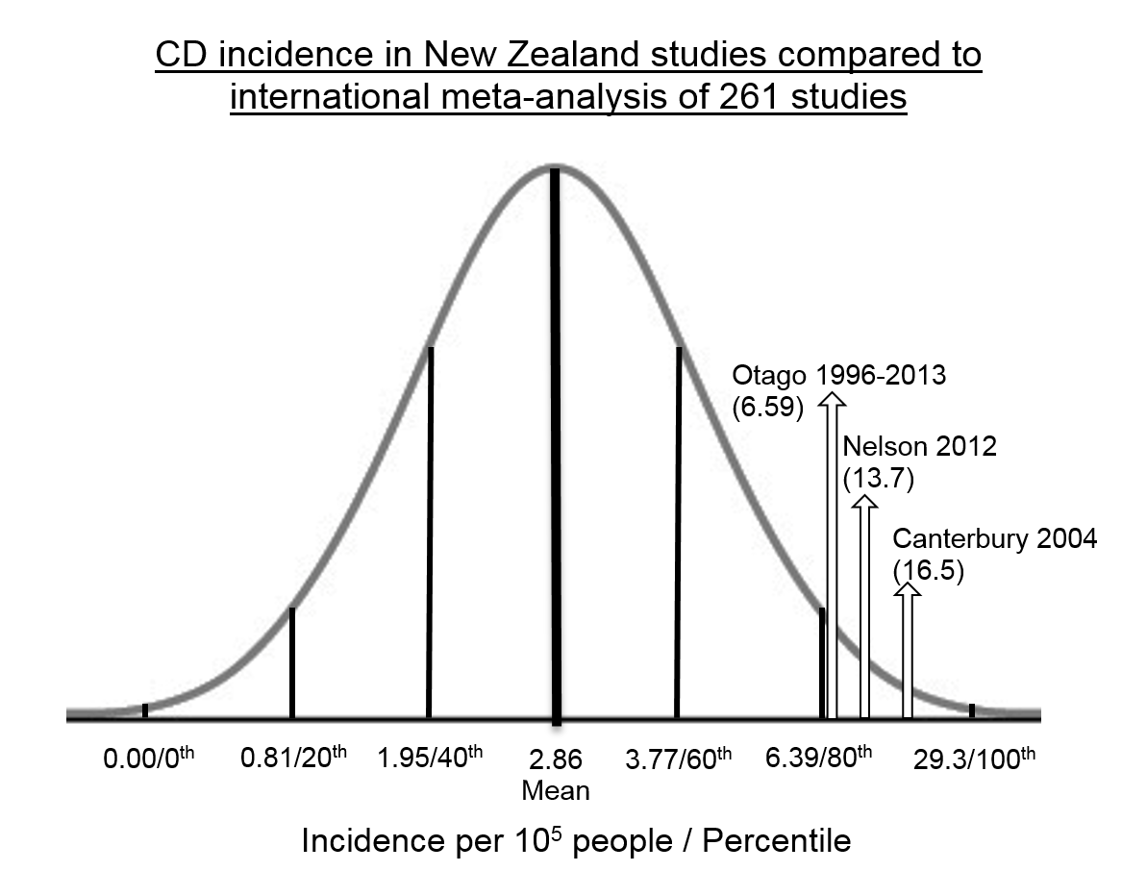
IBD - Incidence
Aluzaite K et al., Intest Inflam Dis 2018

Slide 5


IBD - Prevalence
Dunedin 2016
New Zealand 2016
Total patients: 964
Crohn’s disease: 405
Ulcerative colitis: 239
IBDu: 35
IBD 2016: 20,792
IBD 2026: 41,198
A comparison of prevalence to other conditions in NZ
Schizophrenia approx 14,000 people
Type 1 Diabetes approx 21,450 people
Bipolar between 30,000 and 40,000 people
NEW database in 2021: Crohn’s and Colitis Cure
Notes:
greeting

Slide 6
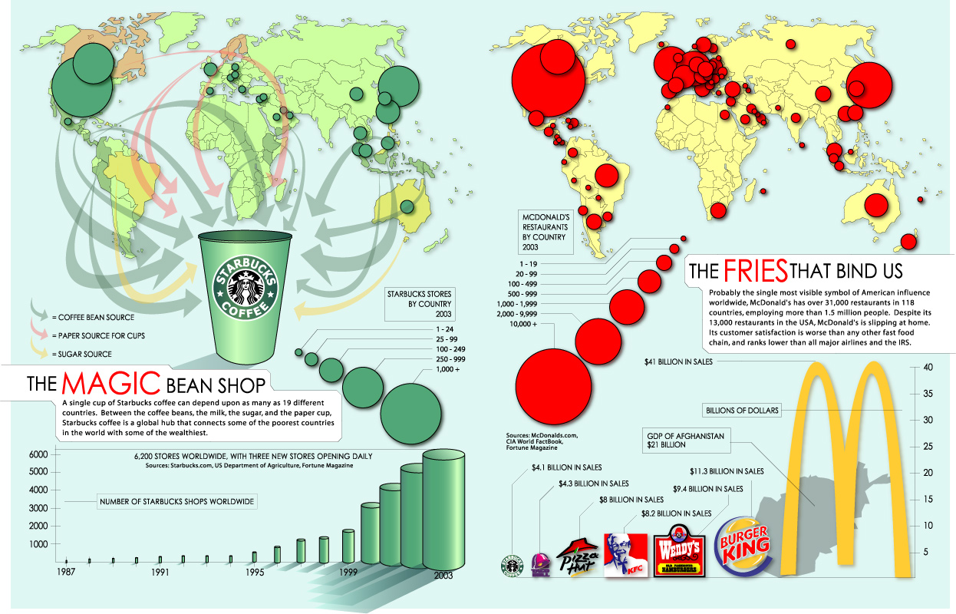
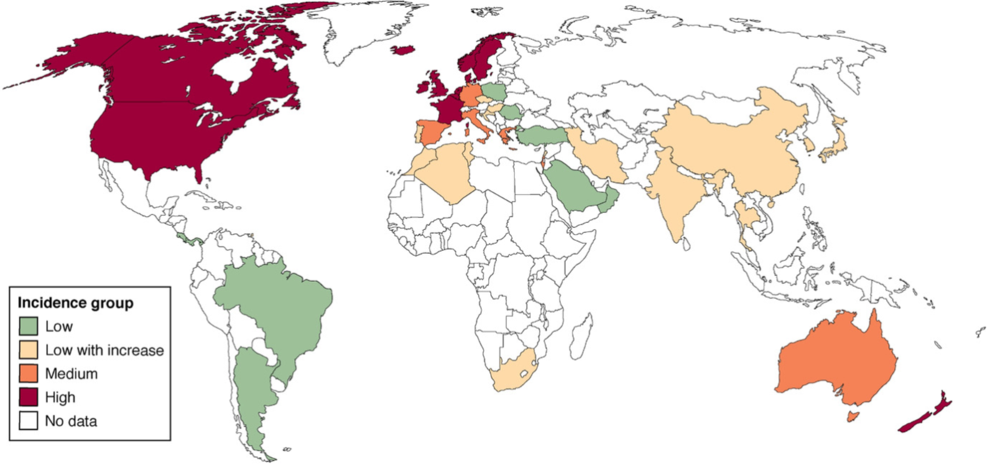
IBD – Disease Mechanisms
North
South

Slide 7
But why is that?
Genetic predisposition
Bacteria
Environment
And?

Slide 8
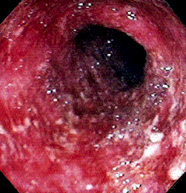
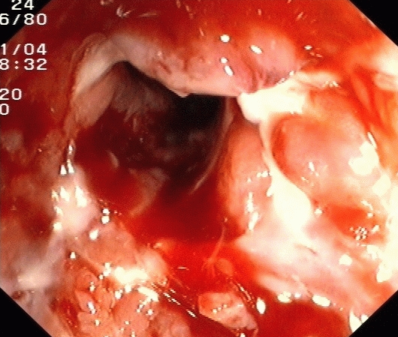
IBD – Disease Mechanisms
The pathogenesis of IBD is multi-factorial
Ulcerative colitis
Crohn’s disease
Sartor 2006
Two hit theory!
Notes:
greeting

Slide 9
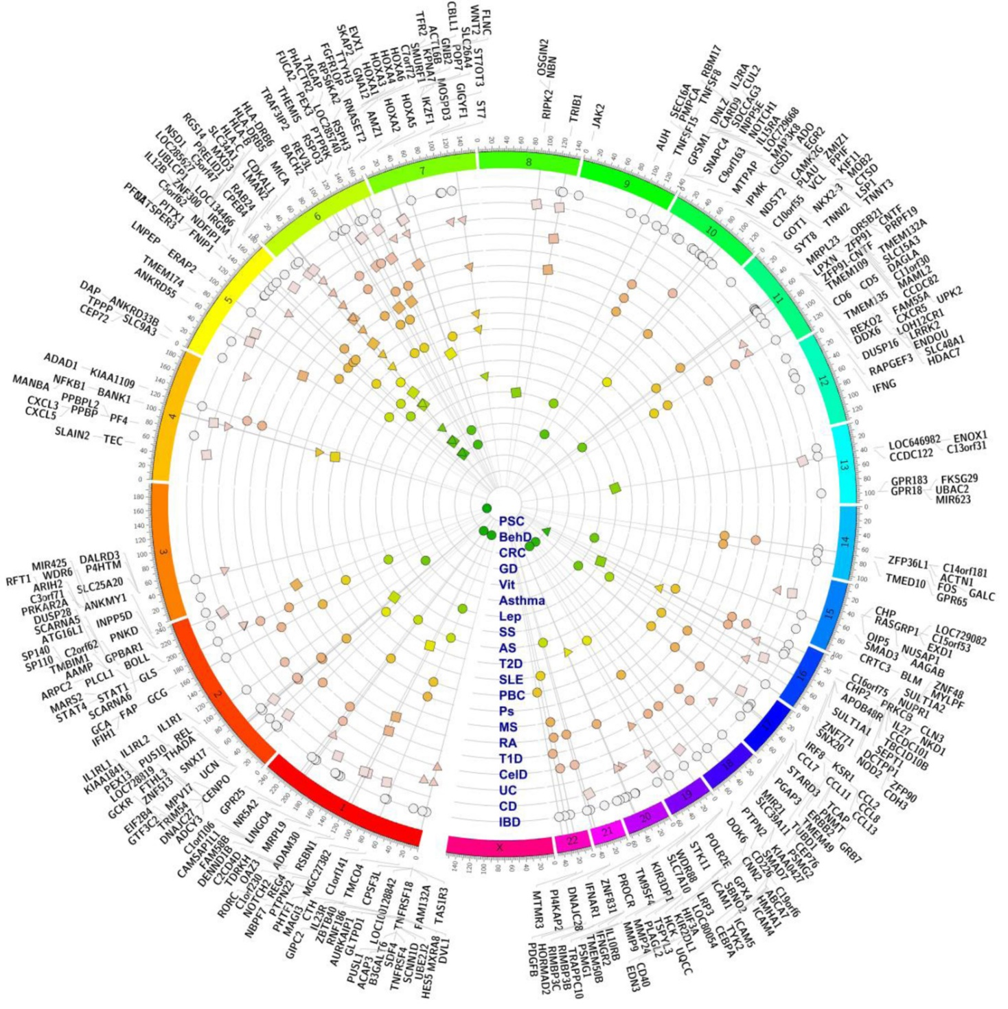
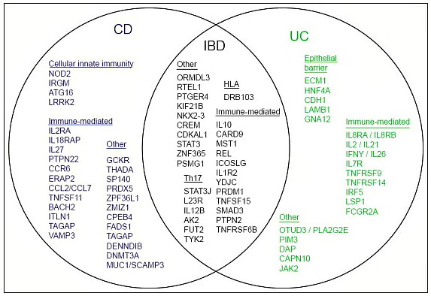
Genes
>200 susceptibility loci for IBD
5% pts have a family history
Overlap with:
Ankylosing Spondylitis
Psoriasis
Primary Sclerosing Cholangitis
NOD2/Card15/IBD1
not necessary and not sufficient
(20% controls)
mutations account for ~20% conferring a 40-fold risk
8-17% Caucasian CD
0% Japanese CD
Notes:
greeting

Slide 10
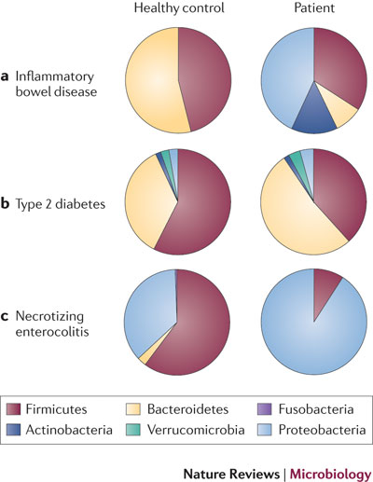
Gut Bacteria
Aymé Spor, Omry Koren & Ruth Ley
Nature Reviews Microbiology 9, 279-290 (April 2011)
Notes:
greeting

Slide 11
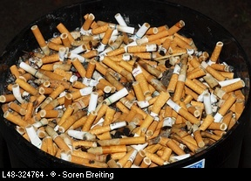
Environment
For example:
UC is a disease of NON-SMOKERS
Smoking is ‘beneficial’ for UC
both passive (childhood) and active (adulthood) smoking decrease the risk of UC
Smokers with CD have a 34% higher relapse rate
Recommendation
CD: encourage patients with CD to STOP smoking
UC: inform about the relationship but do not encourage!
Notes:
greeting

Slide 12
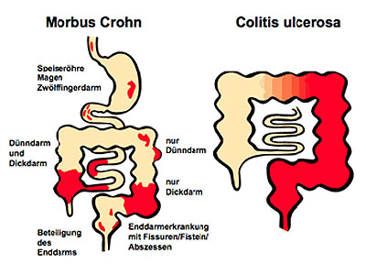
IBD - Symptoms
Crohn’s Disease
Diarrhea
Weight loss
Fever
Night sweats
Growth retardation
Abdominal pain
Lab marker
WBC
Platelets
Albumin
Iron
Hb
Faecal calprotectin
Remission & Flare up
Crohn’s Disease
Ulcerative Colitis
Strongly dependent on location!
Ulcerative colitis
Bloody diarrhea
Lab marker
WBC
Platelets
Iron
Hb
Faecal calprotectin

Slide 13
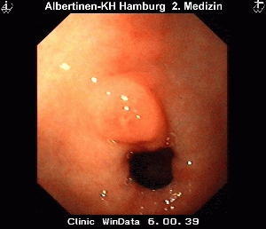
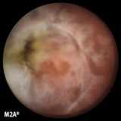
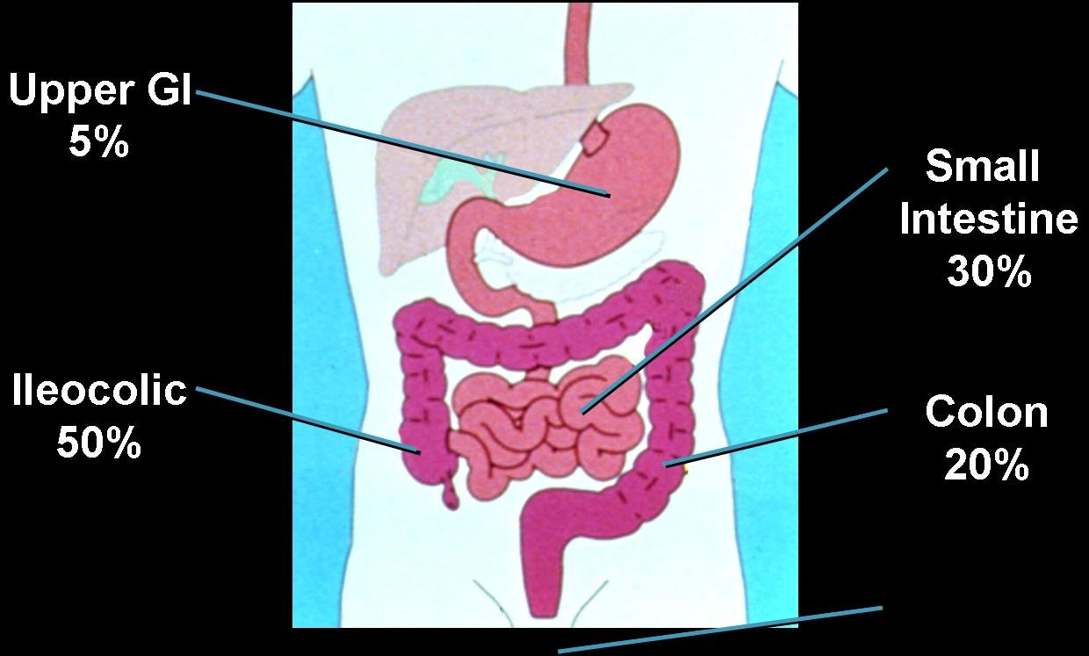
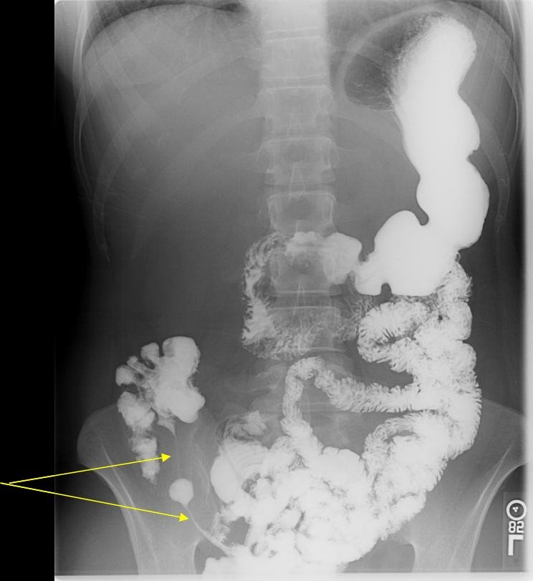
Crohn’s Disease: small bowel, large bowel, extra-intestinal
manifestations, complications, etc.
CD - Treatment
Upper GI
5%
Ileocolic
50%
Colon
20%
Notes:
greeting

Slide 14
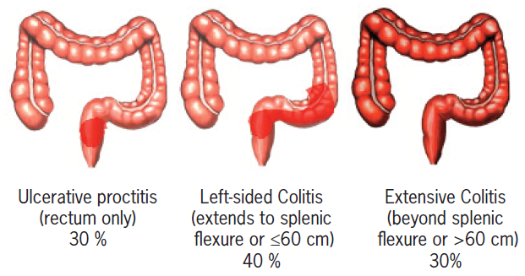

UC - Treatment
Distal colitis Pancolitis
Notes:
greeting

Slide 15
Treatment Options
Treatment options:
Systemic
Topical
Immunomodulators
Biologicals
Notes:
greeting

Slide 16
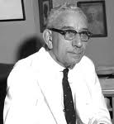

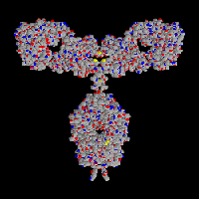
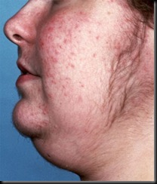
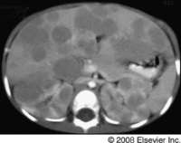
Treatment
1932
1949
1955
1985
1988
1995
1996
The Future
Nutrition
MTX
Steroids
Burrill Crohn
Patient
Azathioprine
Genetics
Individualised
Treatment
TNFα
antibody
Salazopyrine
Mesalazine
5-ASA
Funded in NZ since August 2009!

Slide 17
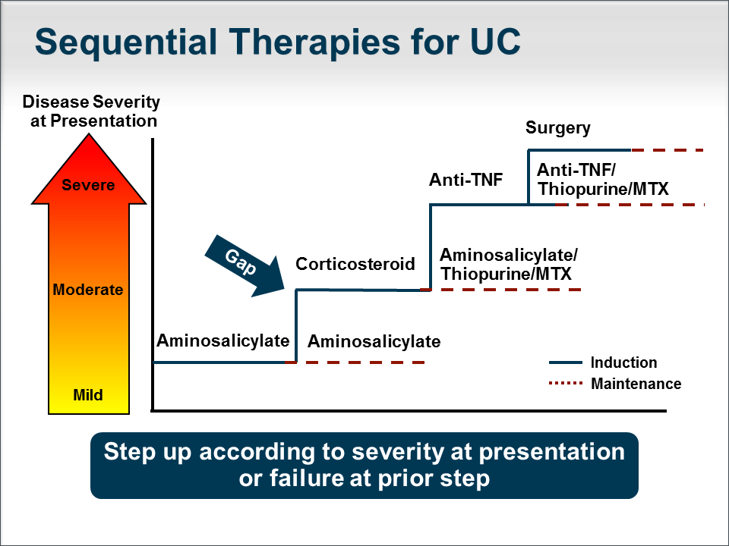
Treatment
Sequential Therapy
Side effects of treatment
Steroids
- weight gain
- acne
- mood disturbances
- infections
Thiopurines
- malignancy
- pancreatitis
- myelosuppression
Anti-TNF
- opportunistic infections
- malignancy
Surgery
- infertility
- complications

Slide 18
CD - Treatment Aim

Slide 19
CD - Treatment
Acute Flare
Oral 5-ASA (Pentasa/Asacol)
O/P
Oral steroids (~3 months)
i.v. steroids (~5 days)
Hospital
Remission
Azathioprine/6-MP/MTX
O/P
Oral 5-ASA (Pentasa/Asacol)?
Biologicals
Complications
Hospital
Surgery
Notes:
greeting

Slide 20
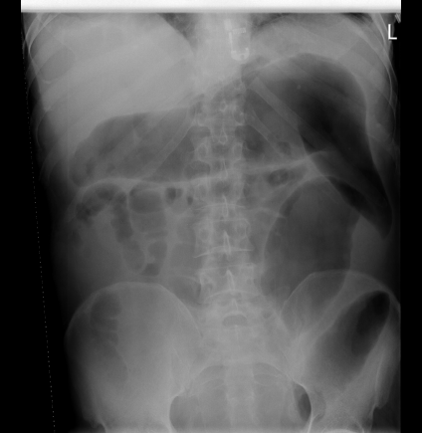
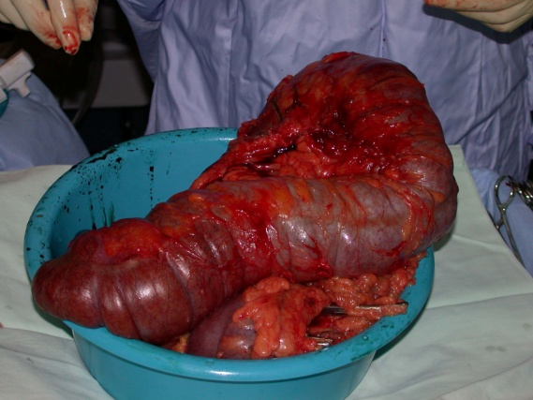
UC - Treatment
Distal colitis
Pancolitis
5-ASA (supp.)
Oral 5-ASA
5-ASA (enema)
Oral Steroids
Steroid (foam)
i.v. steroids
Oral 5-ASA
biologicals
Remission
Remission
Oral/i.v. Steroids
Oral 5-ASA/Azathioprine
Complications
i.v. cyclosporine
biologicals
surgery
Notes:
greeting

Slide 21
Individual Medications
Steroids
Treatment Examples
Community - Prednisone 40mg oral once daily for 2 weeks, then reduce by 5mg/week and stop
Hospital - Methylprednisolone 40mg morning and 20mg night i.v. for 3-5 days,
then reduce by 20mg (night-time dose) for 2 days and then convert to oral
Notes:
greeting

Slide 22
Steroids
Crohn’s disease
n = 173
Ulcerative colitis
n = 185
74 (43%) treated with steroids
Immediate Outcome
  Remission 58%
  Partial remission 26%
  No response 16%
One year Outcome
  Prolonged response 32%
  Dependence 28%
  Operation 38%
63 (34%) treated with steroids
Immediate Outcome
  Remission 54%
  Partial remission 30%
  No response 16%
One year Outcome
  Prolonged response 49%
  Dependence 22%
  Operation 29%
Don’t forget Calcium and Vitamin D
Notes:
greeting

Slide 23
Individual Medications
Thiopurines
Treatment Examples:
Azathioprine 2.5mg/kg BodyWeight – usually 150-200mg per day orally
Special Situation – shunters: Azathioprine 50mg together with Allopurinol 50-100mg
6-mercaptopurine 1-1.5mg/kg BodyWeight – usually 50-100mg per day orally
Notes:
greeting

Slide 24
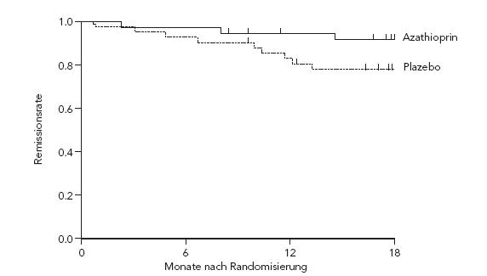
Thiopurines
Adverse Effects
Controversial
Adverse Effects
Sustained Effect
Idiosyncratic (5-10%)
    allergic /pancreatitis
Dose dependent (2-3%)
    hepatic toxicity
    myelosuppression
Myelosuppression
    ~ 2% patients
      from 2 weeks – 11 years
    dose dependent myelosuppression is unpredictable
    can be severe and life threatening
    may be linked to TPMT
Postoperative infection rates
Pregnancy
    no evidence of teratogenicity
    no effect on male fertility
Malignancy
  Increased risk
    NHL in 4/782 patients
    (Significantly higher than expected)
  No increased in risk
GE 2003:320 | All | Major
Steroids | 3.69 | 5.54
AZA / 6MP | 1.68 | 1.2
Randomisation following at least 42 months of Azathioprine
Bahi M et al. 2017
Notes:
greeting

Slide 25
Individual Medications
Biologicals
Treatment Examples:
Humira 40mg sub cutaneous injection every 2 weeks (maintenance)
Infliximab 5mg/kg BodyWeight infusion every 8 weeks, usually 300-500mg
Notes:
greeting

Slide 26
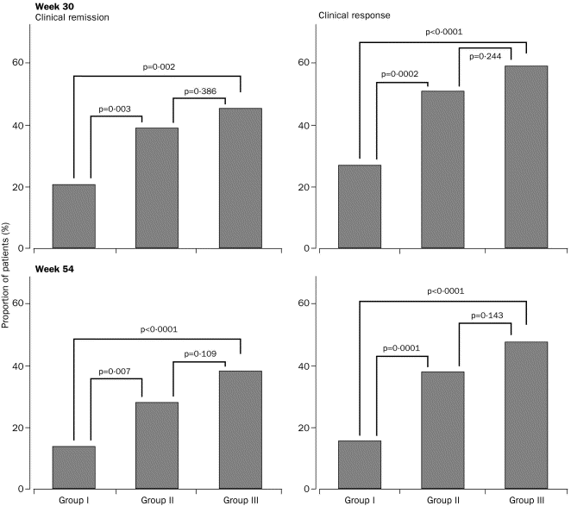
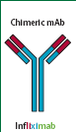
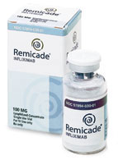
Biologicals - Infliximab
Crohn’s Disease
All patients:
5mg/kg at baseline
then 8-weekly
Group I – Placebo
Group II – 5mg/kg
Group III–10mg/kg
I
II
III
I
II
III
Analysis:
8-weekly better than once only BUT
No difference between 5 or 10mg/kg
ACCENT I
Lancet 2002;359:1541
Notes:
greeting

Slide 27
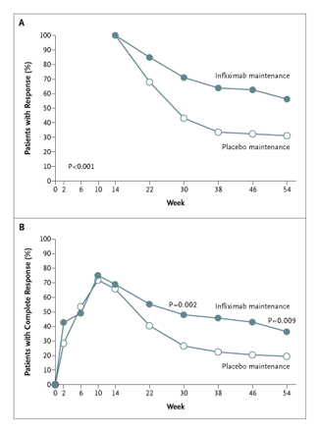
Response (>50% reduction)
Complete response
(closure of fistula)
ACCENT II
NEJM 2004;350:876
Notes:
greeting

Slide 28
Biologics - Infliximab
Acute Disease – Ulcerative Colitis
moderately severe, steroid-refractory
(ACT I) or on mesalamine (ACT II)
Remission
Response
ACT I + III NEJM 2005
Notes:
greeting

Slide 29
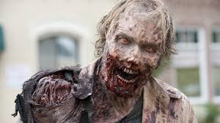
Treatment - Safety
Oesophageal candidiasis, candida sepsis
CMV
Herpes
Notes:
greeting

Slide 30
Infliximab cost at the CDHB

Slide 31
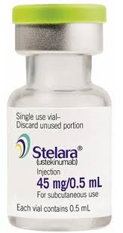
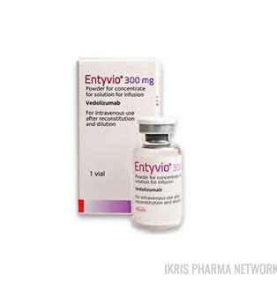
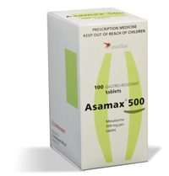
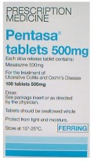
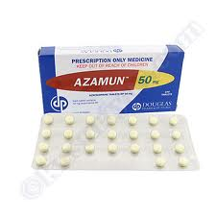
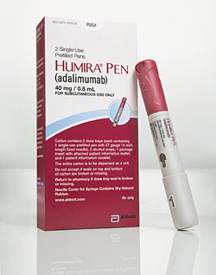
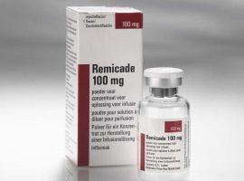
Options
Crohn’s Disease
Ulcerative colitis
Medication | Formulation | Induction | Maintenance | Induction | Maintenance
5-ASA, mesalamine | Suppositories | N | N | Y | Y
 | Enema | N | N | Y | Y
 | Tablets | N | Y | Y | Y
Steroids | Systemic | Y | N | Y | N
 | Enteric | Y | N | N | N
 | Enema | N | N | Y | N
Immunomodulation | Tablets | N | Y | N | Y
 | s.c. | N | Y | N | Y
Biologicals | Infusion | Y | Y | Y | Y
 | s.c. | Y | Y | Y | Y
Surgery |  | Y | N | Y | Y
Notes:
greeting

Slide 32
Infliximab outcomes
100
Therapeutic Gap
75
Combination
Efficacy
50
Biologics
(%)
25
Immune suppressants
0
0
2
4
6
8
10
12
Months

Slide 33
The Future
1932
1949
1955
1985
1988
1995
1996
The Future
Nutrition
MTX
Steroids
Burrill Crohn
Patient
Azathioprine
Genetics
Individualised
Treatment
TNFα
antibody
Salazopyrine
Mesalazine
5-ASA
Funded in NZ since August 2009!

Slide 34
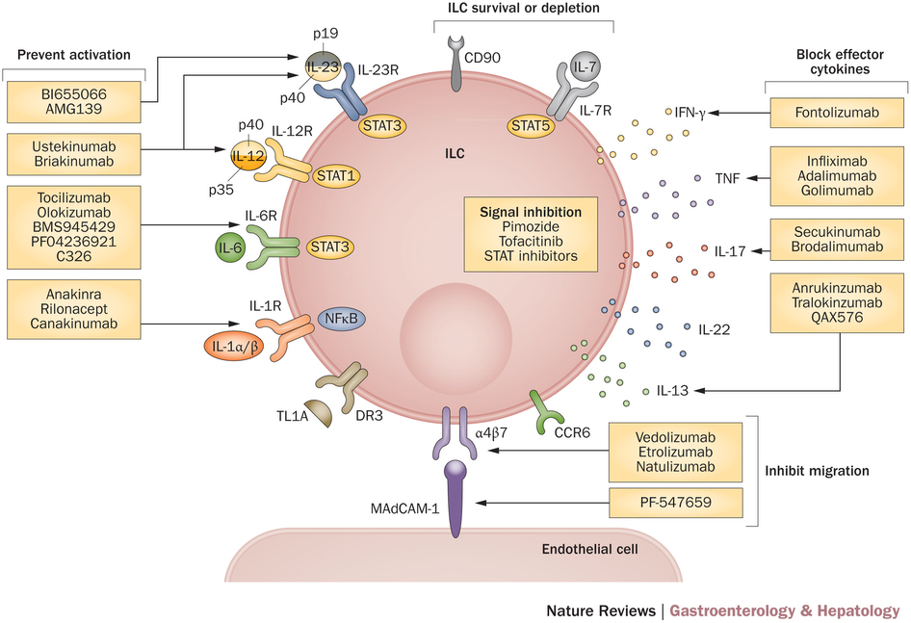
The Future - Immunology
Notes:
greeting

Slide 35
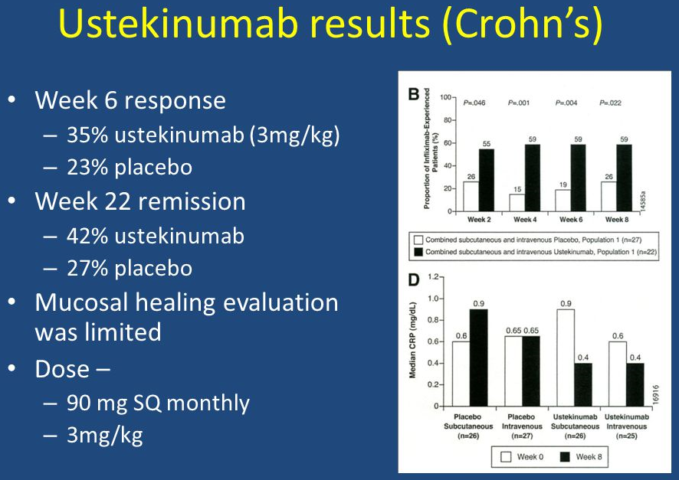
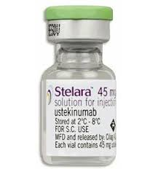
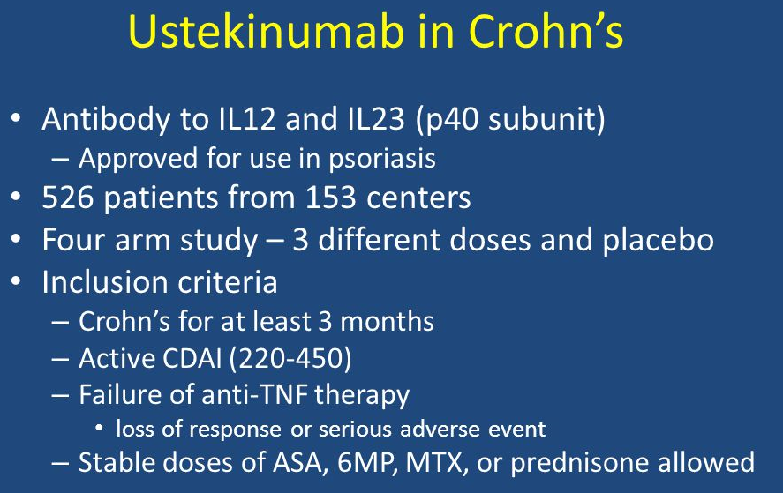
Stelara
Anti IL12/IL23 p40 subunit
Notes:
greeting

Slide 36
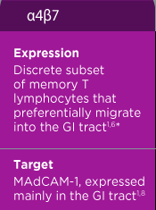
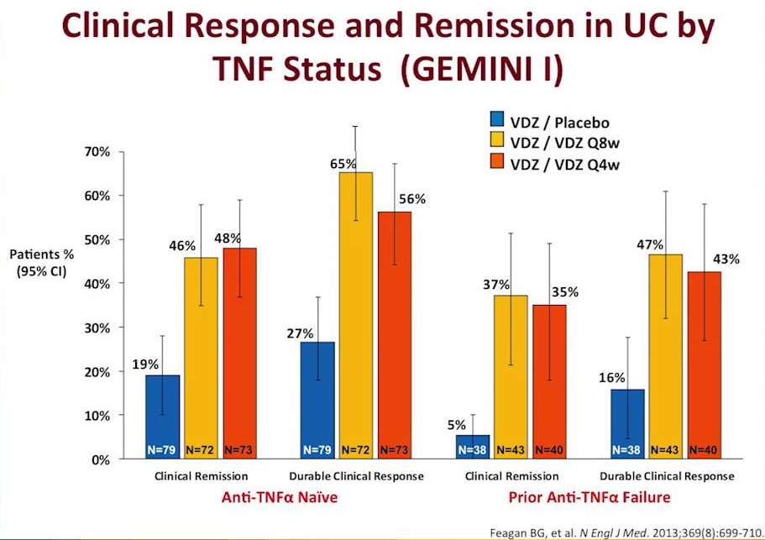
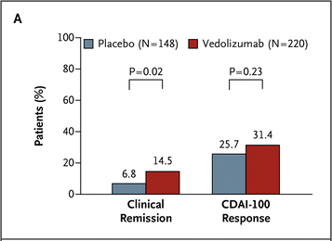
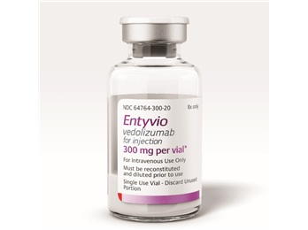
Entyvio
Vedolizumab – anti-integrin α4β7
Notes:
greeting

Slide 37
Summary
Crohn’s disease and ulcerative colitis – genetics, bacteria and environment
Treatment is effective
New treatment options are on the horizon

